Slide 1

SVA & App Interface
Zhao lei

Slide 2
Contents
1
Protocols
2
API Introduction
3
API Details
4
References

Slide 3
Protocols
Requirements：
1.Familiar with HTTPS & AMQP
2.Basic knowledge of digital certificate authentication and encryption
HTTPS
the client must support HTTPS 0.9 or above.
AMQP
the client must support AMQP v1.0 and use the tools that speak AMQP must be compatible with qpid .

Slide 4
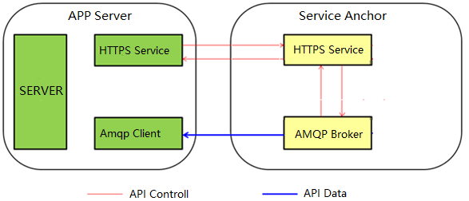
API Introduction
Classic publish/subscribe paradigm：
1.App Server get subscribe information from Service Anchor through the API Controll Channel;
2.Amqp Client open the Ampq Channel,receiving data published by Service Anchor.

Slide 5
API Details
Step 1: Authentication
HTTPS
Setp 2: Subscription
Step 3: Open Amqp Channel
AMQP
Step 4: Receive Data
Step 5: Unsubscription
HTTPS

Slide 6
API Details
Step 1:Authentication
Note:
Before sending authentication request，you have to apply for a username & password from Service Anchor.
Method :post
Url :/host_ip:9001/v3/auth/tokens
Content type : json
Param :
 | function | optional | details | type | length
domain | User domain | False | Fixed to “API” | String | 1-32
name | User name | False | Assigned by SVA | String | 1-32
password | password | False | Assigned by SVA | String | 6-32
iplist | Trusted ip list | True | Support ipv4 only, | String

Slide 7
API Details
Step 2:Subscription
locationstream
locationstreamanonymous
Geofencing
Networkinfo
Location information with real user identification
Location information with anonymous
user identification
Electronic fence event for the specified area
Network information

Slide 8
API Details
Step 2:Subscription--locationstream
Method :post
Url :/host:9001/enabler/catalog/locationstreamreg/json/v1.0
Content type : json
Param :
 | function | optional | details | type | length
appid | User name | False | Assigned by SVA | String | 1-32
useridlist | User list | true | * | String | 1-32
* When requesting with useridlist, the SVA will only send location info that corresponding to the userid in useridlist.Or the SVA will send the location info of all users.
Note:if the given appid is already used to make a lcoationstream subscription with specified useridlist,then it cannot be used to subscribe location info of all users, vice versa .

Slide 9
API Details
Step 2:Subscription--locationstream
Method :post
Url :/host:9001/enabler/catalog/locationstreamanonymousreg/json/v1.0
Content type : json
Param :
 | function | optional | details | type | length
appid | User name | False | Assigned by SVA | String | 1-32

Slide 10
API Details
Step 2:Subscription--geofencing
Method :post
Url :/host:9001/enabler/catalog/geofencing/json/v1.0
Content type : json
Param :
 | function | optional | details | type | length
appid | User name | False | Assigned by SVA | String | 1-32
idtype | Type of id | true | Default value is “ip”,choose “mac” when using wifi. | String | 1-16

Slide 11
API Details
Step 2:Subscription--networkinfo
Method :post
Url :/host:9001/enabler/catalog/networkinfo/json/v1.0
Content type : json
Param :
 | function | optional | details | type | length
appid | User name | False | Assigned by SVA | String | 1-32
infotype | Network type | False | Ransignal | String | 1-16
useridlist | List of userid | False | Specified userid | String | -
Note: this function is for internal test only, not valid to public.

Slide 12
API Details
Step 3: Open Amqp Channel
There are many tools which speak AMQP,like RabbitMQ, ActiveMQ.Here we use Qpid as the client tool to communicate with Service Anchor.
When connecting to SVA through Amqp, it needs both Server Authentication and Client Authentication.
The certificates are supplied by SVA.

Slide 13
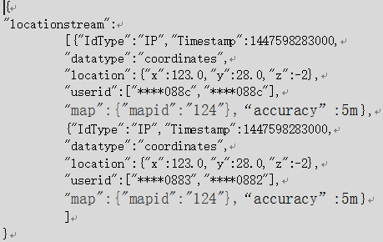
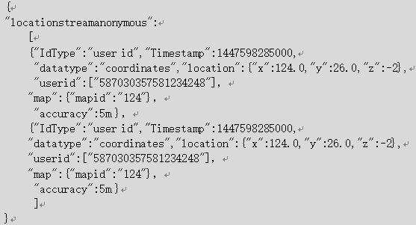
API Details
Step 4: Receive Data
The following pics show the data received from SVA.
non-anonymous
anonymous

Slide 14
API Details
Step 5: Unsubscription
Familiar with subscription,differing in urls and parameters.

Slide 15
Thank You !

